Slide 1
Cancer Biology
Stephen Riechens PA-C
Feb.2011

Slide 2
Objectives
Understand the significant cellular and genetic events that cause cancer and clinical features of neoplastic diseases.
Be able to contrast and differentiate types of cancer/neoplasia by histological origin, as well as the staging system.
Be familiar with the general principles of treatment, such as CTX and XRT.
Understand the role of cancer screening.

Slide 3
Oncology Terminology
Neoplasia
(new growth) abnormal proliferation of cells in a tissue or organ, used as synonymous to tumor
Hyperplasia
proliferation of cells # within an organ that may result in gross enlargement in response to a physiological stimulus, remains under normal regulatory control mechanisms, breast during pregnancy
Hyperthrophy
increased in cell size, as in weight training and steroid therapy

Slide 4
Oncology Terminology
Dysplasia
early form of pre-cancerous transformation detected in a Biopsy or Pap-smear. Cells are different from the tissue of origin
Carcinoma “in situ”
“cancer in place”, cells have lost their tissue identity, growth is rapid and without regulation, however remains localized to a specific area or organ
Invasive Carcinoma
invading beyond the original tissue layer or location, may be able to spread to another parts of the body (Metastasize)

Slide 5
Oncology Terminology
Metaplasia
- changes in response to chronic physical or chemical irritation such as cigarette smoking that causes the mucus secreting Ciliated epithelium to be replaced by Simple Squamous epithelium; the change is benign and reversible to certain limit
Some cells go from:
- Metaplasia-Dysplasia-Neoplasia

Slide 6
Oncology Terminology
Adenoma
collection of growth(-oma) of glandular origin, benign but may compress other structures (mass effect) or produce large amounts of hormones (para-neoplastic syndromes),
may become malignant and they are called Adeno-carcinomas

Slide 7
Oncology Terminology
Paraneoplastic Syndromes : mediated by humoral factors (hormones and cytokines) excreted by tumor cells or by immune response against the tumor. Symptoms may show before diagnosis of malignancy
  SIADH – small cell lung cancer and CNS malignancies
  Hypercalcemia – Breast and Lung cancer due to production of PTHrp

Slide 8
Oncology Terminology
Sarcoma : cancer that affects connective, supportive and soft tissue (bone, cartilage, muscle or fat)
  Osteosarcoma – bone
  Chondrosarcoma – cartilage
  Leiomyosarcoma – smooth muscle

Slide 9
2006 Estimated US Cancer Deaths*
Lung & bronchus 31%
Colon & rectum 10%
Prostate 9%
Pancreas 6%
Leukemia 4%
Liver & intrahepatic 4%
bile duct
Esophagus 4%
Non-Hodgkin 3%
Urinary bladder 3%
Kidney 3 %
All other sites 23 %
291,270 deaths in Men
26% Lung & bronchus
15% Breast
10% Colon & rectum
6% Pancreas
6% Ovary
4% Leukemia
3% Non-Hodgkin lymphoma
3% Uterine corpus
2% Multiple myeloma
2% Brain/ONS
23% All other sites
273,560 deaths in Women

Slide 10

2006 Estimated US Cancer Cases*
Prostate 33%
Lung & bronchus 13%
Colon & rectum 10%
Urinary bladder 6%
Melanoma of skin 5%
Non-Hodgkin 4% lymphoma
Kidney 3%
Oral cavity 3%
Leukemia 3%
Pancreas 2%
All Other Sites 18%
Men 720,280
31% Breast
12% Lung & bronchus
11% Colon & rectum
6% Uterine corpus
4% Non-Hodgkin
lymphoma
4% Melanoma of skin
3% Thyroid
3% Ovary
2% Urinary bladder
2% Pancreas
22% All Other Sites
Women 679,510

Slide 11

Five-year Relative Survival (%)* during Three Time Periods By Cancer Site
74-76 83-85 95-2001
All sites 50 53 65
Breast (female) 75 78 88
Colon 50 58 64
Leukemia 34 41 48
Lung and bronchus12 14 15
Melanoma 80 85 92
Non-Hodgkin 47 54 60
Ovary 37 41 45
Pancreas 3 3 5
Prostate 67 75 100
Rectum 49 55 65
Urinary bladder 73 78 82

Slide 12
Hallmarks of the Cancer Phenotypes
Autonomy
Insensitivity to anti-growth signals
Resistance to apoptosis
Limitless replicative potential
Induction of Angiogenesis
Tissue invasion and metastasis

Slide 13
Pathways to Cancer
Exposure to environmental carcinogens
Dysregulated DNA repair
Random replication errors
Hereditary germline mutations in a cancer gene

Slide 14
Genes responsible for cancer
Oncogenes
Tumor-Suppressor Genes
Stability Genes

Slide 15
Epidemiology
Cancer incidence rates - number of new cases per 100,000 people
Age group specific risk, or lifetime risk - describes the risk of developing a particular type of cancer in a specific population
Survival rates expressed as relative survival rate: % of people with the disease who are alive 5 years after the diagnosis

Slide 16
Epidemiology
Prevalence of a disease: number of people living with the disease
Survival rates are poorer in African -Americans in the US
Survival rates are higher for “limited Ds” than for “regional” than for “metastatic” disease

Slide 17
Cancer Etiologic factors
Tobacco : lung, esophagus, head and neck, stomach, pancreas, kidney, bladder and cervix
Alcohol : squamous cell cancer of the oral cavity, pharynx, Larynx, esophagus, liver, rectal, and breast cancer
Asbestos : mesothelioma, lung

Slide 18

By simply identifying smokers, advising them to quit, and sending them to a FREE telephone service, clinicians can save thousands of lives.

Slide 19
Cancer Etiologic factors
Infectious agents: Hepatitis B and C virus-liver cancer, HPV-cervical and anal cancer, HIV induced immunodeficiency associated with Kaposi’s sarcoma, certain lymphomas, and anal cancer
Pharmacologic agents: estrogens-uterine and breast cancer
Diet : breast, colon and stomach

Slide 20
Cancer Prevention
Primary prevention - keeps disease from occurring by reducing exposure to causative agents and risk factors
Secondary prevention - detects the disease before it is symptomatic and when intervention can prevent the illnes,
Tertiary prevention - reduces complication of the disease once the disease is clinically evident

Slide 21
Primary Prevention
Avoiding the causative agent
  Lifestyle risk reduction measures
Using an agent that prevents the development of the malignant process
  Chemo-preventive agents
  Vaccines

Slide 22
Secondary Prevention
Achieved with screening tests
Screening tests do not prevent the disease
Screening tests are not diagnostics on their own
No screening test for most type of Cancers

Slide 23
Criteria for Screening test
Common and severe disease
Long asymptomatic phase during which intervention is beneficial
Effective intervention available
Early Tto. More effective than later Tto.
Test sensitive and specific, inexpensive and safe

Slide 24
Screening tests
Annual Mammogram for women > 50 y.o.
Annual Clinical Breast Examination
Annual Pap Smear for women within 3 years of beginning sexual intercourse, but no later than 21 years of age
Annual Fecal occult blood testing, Flexible Sigmoidoscopy and Barium enema every
5 years or Colonoscopy every 10 years

Slide 25
Screening tests
Sensitivity
- likelihood of a positive test in a person with the disease
  A 100 % sensitive test is never negative in a person who has the disease
  0 % false negative rate
Specificity
- likelihood of a negative test in a person free of the disease
  A 100 % specific test is never positive in a person without the disease
  0 % false positive rate

Slide 26
Screening tests
Positive predictive value (PPV) : likelihood that a person with a positive test has the disease
Negative predictive value (NPV) : likelihood that a person with a negative test result does not have the disease

Slide 27
Genetic Screening
DNA testing for several type of cancers
    Breast, Ovarian, Colon cancer Syndromes
    Reserved for strong family history
Must receive counseling before and after the test
    Test limitations
    Prevention options available
    Risk of having a positive test result
    Side effects of prevention measures

Slide 28
Genetic Screening
Possibility of discrimination
    employers, friends and family
Negative test results meaning
    Risk of cancer is not zero
    Risk of cancer is similar to that of the general population

Slide 29
Principles of Cancer Therapy
Chemotherapy - mainstay of therapy
Development of more Specific Targeted Agents
Increased anticancer agents Clinical trials
Refined Surgery and Radiation therapy as effective treatment for localized lesions
Considerable resources for Palliative care of cancer patients

Slide 30
Diagnosis and Staging
Histologic Diagnosis - Invasive Biopsy
  Morphology, invasiveness, molecular markers
Tumor staging - Clinical or Pathological
  Clinical : PE and Imaging studies
  Pathological : follows Tumor(T), Node(N), Metastasis(M) (TNM method).

Slide 31
TNM method for Staging of Tumor
T - score: size and extent of invasion
of the primary tumor
N - score: number and location of histologically involved regional lymph nodes
M - score: presence or absence of distant metastasis.

Slide 32
Tumor Staging
TNM scores are group into categories from I - IV reflecting increasing burden of the disease
Has prognostic and therapeutic implications

Slide 33
Tumor Staging
Example of tumor staging:
T2-N1-M0 (stage III) Colon cancer
  Resected Colon Cancer that invades the muscularis propia, involves 2 of the 16 lymph nodes but has no distant metastasis
  Tumor recurrence is 40-50%
  Six months of chemotherapy is recommended

Slide 34
Biomarkers
Provide additional prognostic information
Absence of Hormone receptors in breast cancer indicate poor prognosis
Presence of HER-2/neu in breast cancer indicates positive anti - neoplastic response to Trastuzumab
Notes:
Human epidermal growth factor receptor 2 +

Slide 35
Tumor markers
Serum levels of proteins used for diagnosis of tumors
Carcino-Embryonic Antigen (CEA) for colon cancer
Alpha feto protein in testicular and liver cancer

Slide 36
Surgery in cancer
Prevention
    Precancerous lesion removal
    Removal organs at risk
Diagnosis
    Biopsy
Treatment
    Removing the primary tumor

Slide 37
Surgery in cancer
Staging
    Sampling lymph nodes
Reconstruction
    A sacrificed limb or organ
Palliative treatment
    Intestinal bypass - obstruction
    Spinal cord decompression

Slide 38
Radiation therapy
Definitive therapy either alone or with chemotherapy
Can preserve organ structure and function-enhanced quality of life
Palliative to alleviate pain
Brachytherapy: radioactive sources that deliver radiation directly to the tumor
    Iodine seeds into the prostate

Slide 39
Radiation side effects
Acute effects seen in days-weeks in rapid proliferating tissues(skin and GI mucosa) usually reversible, depending on total dose
Late effects seen in months -years, necrosis, fibrosis, and organ failure
Secondary malignancies

Slide 40
Medical therapy
Chemotherapy- cytotoxic agents for treatment of Cancer
Most anti-proliferating agents
More effect in rapid proliferating tissues: BM, GI mucosa

Slide 41
Medical therapy
Chemotherapeutic Agents
  Cell cycle specific and non-specific
  Alkylating agents
  Anti-metabolites
  Antitumor antibiotics
  Mitotic spindle inhibitors

Slide 42
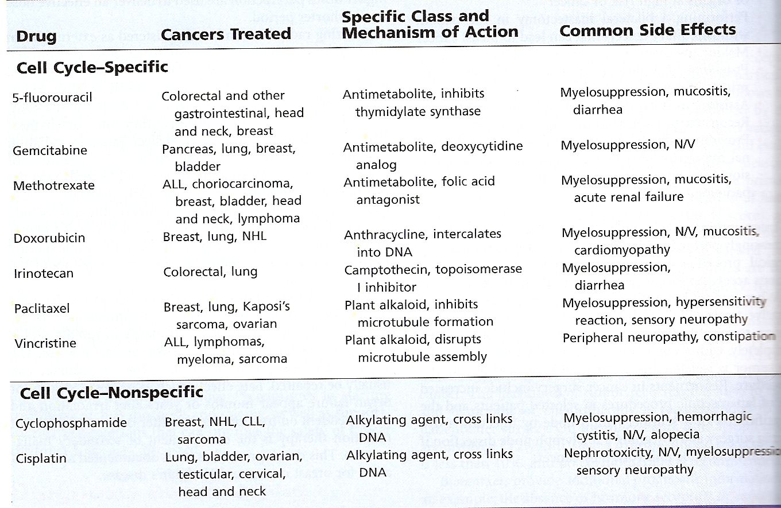
Chemotherapeutic Agents

Slide 43
Medical therapy
Most used in treatment of metastatic disease not achieved by surgery or radiation
  Curative - certain lymphoma and testicular cancer
  Adjuvant - chemotherapy after resection of the primary tumor (breast, lung cancer)
  Neoadjuvant - primary chemotherapy, used before surgery, sometimes in combination with radiation

Slide 44
Evaluation of Response
Monitoring based on PE and serial radiologic methods of the affected sites
Complete response: disappearance of all lesions
Partial response: > 30% or greater reduction in the long diameter
Progression: new lesions or increased in size of the existing lesion 20 %

Slide 45
Evaluation of Response
Stable disease: not responding, not progressing
Response rate: % of patients who experience “a response” while being treated
Gold standard for efficacy of therapy is an improvement in disease-free survival

Slide 46
Targeted Therapeutic Agents
Directed against specific cancer proteins
  Growth factors
  Signaling molecules
  Cell cycle proteins
  Regulators of apoptosis
  Angiogenesis
No N/V, myelosuppression, or alopecia
Multiple combination of therapy available

Slide 47
Targeted Therapeutic Agents

Slide 48
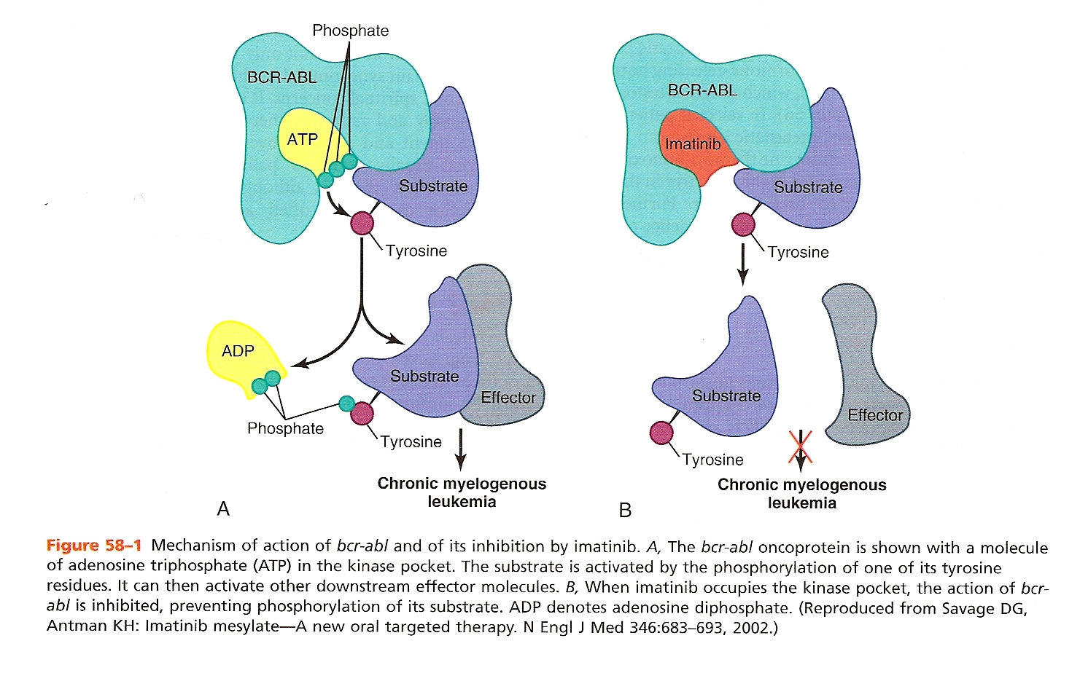
Imatinib Mechanism

Slide 49
Limitations of Chemotherapy
Tumor cells kinetics protect against chemotherapy
  Chemotherapy affects cells in division
  The rate of tumor cells doubling slows as the tumor size increases
  Only 5 % of the tumor is growing when clinically detectable
Cancer cells become resistant to chemotherapy
  Cell membrane efflux pump
  Decreased uptake of the drug

Slide 50
Supportive care
Improve safety and tolerability of chemotherapy
Control of nausea and vomiting
Anemia control with EPO
Shorter duration of neutropenia (GCS-F)
Avoid mucositis (H.Keratinocyte growth factor)
Palliative care for pain syndromes, psychosocial and spiritual concerns

Slide 51
END

