Slide 1


Slide 2




Design influences for future projects and live presentations – HOLDING SCREENS

Slide 3



Design influences for future projects and live presentations – BANNERS

Slide 4
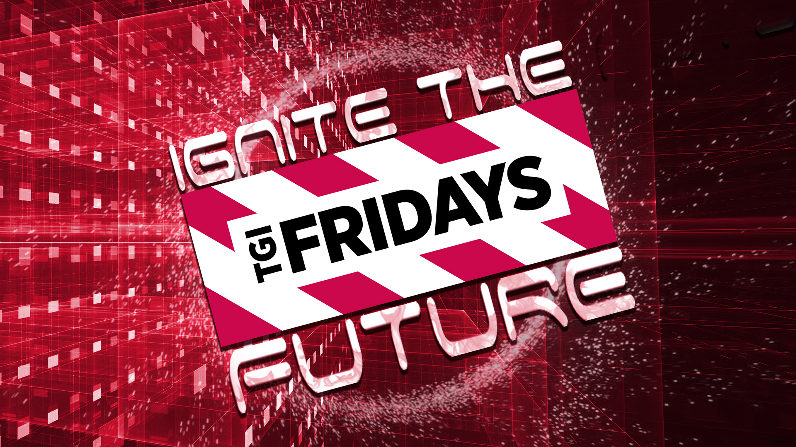

Design influences for future projects and live presentations – BANNERS

Slide 5
BRINGING EAI TO LIFE
VERTICALS
CUSTOMERS
Focus on
Fortune 500
Manufacturing
Channel
Expansion
Healthcare
REGIONAL
OFFERINGS
WLAN, Datalogic Attack, Invest in Growth Counties,
Build Vertical Focused Team, Cross Sell Portfolio
Services Expansion
& Solutions Selling
OS Platform
Migration
Design influences for future projects and live presentations – INDUSTRIALS
Notes:
Priorities in three categories: verticals, customers, offerings <build>
Verticals
Manufacturing – huge market, low share – attack Honeywell with Voice and Dex <build>
Healthcare – high growth, shape the market – mobility, patient identification, specimen and drug tracking <build>
Customers
Many Fortune 500 where we have little/no presence – we will go hunting and use EAI solutions to penetrate <build>
Channel expansion: Expand number of partners in key geos and engage them in EAI solutions with our new channel program <build>
Offerings
Services expansion: Wrap managed and professional services around our offerings <build>
Solutions selling: Reinvent how we sell for solutions such as SNAp <build>
O/S platform migration: Accelerate to second wave of customers + involve the channel <build>
In addition, each region has set priorities <build>
Priorities don’t mean other parts of our business don’t matter. This is where we move resources
We already have some awesome wins behind these priorities

Slide 6


81%
start with a WEB SEARCH
58%
Engage with PEERS
81%
Stated WORD OF MOUTH
IS IMPORTANT
48%
Follow INDUSTRY CONVERSATION
Design influences for future projects and live presentations – INDUSTRIALS
Notes:
Trends—Market Strategy
Placeholder for Data
What are customers experiencing? What influences our customers?
Web analytics, what are people getting excited about
Weaving in EAI
Zebra helps you tap into the category of Enterprise Asset Intelligence by enabling you to offer operational visibility to your customers
More EAI research and info to come
It’s simple. At its core, Enterprise Asset Intelligence is the business category that represents operational visibility. The mega trends of workforce mobility, the Internet of Things and the cloud have made operational visibility a mainstream business need and created unique growth opportunities for Zebra and its partners.
Zebra’s broad portfolio of Visibility solutions gives access to much larger markets that we can take advantage of together.

Slide 7








EAI and the Channel
SENSE
weapons tracking and management and farm to fork application for corrections department
RFID tracking of inventory with data analytics for luxury retailer
Active RFID tracking solution for tracking animals in MOBILE ambulances along eastern seaboard
luggage location tracking for major cruise line
tracking of baking trays for bakery serving major fast food chain
Location and Motion Sensing
Mobile Computing
Cloud-based
Device
Management
ANALYZE
Data
Capture
Software
& Services
Wireless
LAN
Barcode Printing
Card Printing
RFID
REAL TIME PARTNER EXAMPLES
ACT
Design influences for future projects and live presentations – INDUSTRIALS
Notes:
CONTRAST TO 5 YEARS AGO
USED TO LOSE GUNS…DON’T ANYMORE…ALSO CAN MANAGE FOOD SUPPLY FOR INMATES MUCH BETTER
TRACK USAGE OF BUNS VIA NUMBER OF TRAYS USED AND CAN TRACK THE TRAYS (EXPENSIVE ASSET)

Slide 8





Principles of Partner Engagement
Zebra channel partners are vital
to Zebra’s business and our focus on customer delight
We collaborate with our channel partners to provide value for our mutual customers
We invest in
Zebra channel
partners’ success
We strive to provide
the industry’s best
channel partner experience
We work with our channel partners to seize opportunities presented by Enterprise
Asset Intelligence
Design influences for future projects and live presentations – INDUSTRIALS
Notes:
OUR ENGAGEMENT WITH PARTNERS HAS SIGNIFICANT IMPACT IN THEIR PERCEPTION OF THE PROGRAM AND OUR COMPANY
WHILE PARTNERS MAY NOT LIKE EVERYTHING WE DO, THEY HIGHLY VALUE CONSISTENCY AND PREDICTABILITY
ANDERS REVIEWED AT GPS; JULIANN JUST NOW

Slide 9





